Slide 1
Applied A.I. Solutions Development Program
ADVANCED APPLIED MATHEMATICAL CONCEPTS FOR DEEP LEARNING
Malaria Cell Images Dataset
Group 7
Bikash Giri (101575097)
Chia-Wei Chang (101570243)
Diparshan Bhattarai (1014947379)
Gavriel Kirichenko (101119609)
Abdul-Rasaq Omisesan (101571156)
Callum Arul (101585383)
Friba Hussainyar (101591222)

Slide 2
Agenda
Dataset & Business Problem (Bikash)
Model Training & Validation & Evaluation
CNN Model from Scratch (Gavriel)
Vgg16 (Friba)
VIT Model (Chia-wei)
Comparison of All Three Models (Callum)
Streamlit Demo (Abdul-rasaq)
Conclusion with Future Work (Diparshan)

Slide 3
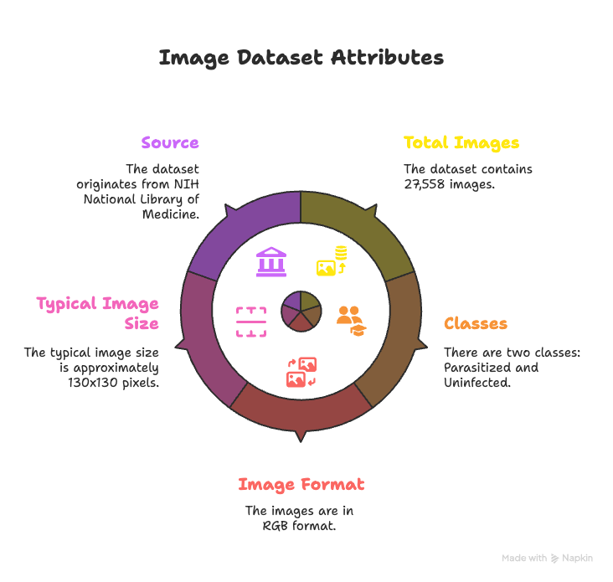
Dataset Source and Insight
The project is based on the data set created by Kaggle called "Cell Images to Detect Malaria" that includes 27,558 labeled segmented cell images concerning the groups of parasitized cells (infected) and non- parasitized cells (healthy).
The images of the RGB format, approximately 224x224 pixels. Which was reduced to 130x130 after preprocessing.
https://www.kaggle.com/datasets/iarunava/cell-images-for-detecting-malaria
Page 1

Slide 4
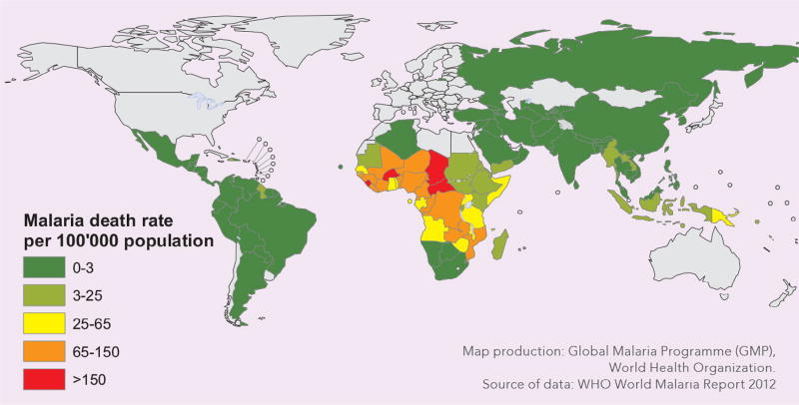
Business Problem
Malaria is still a challenge faced by the global community, especially in sub Saharan Africa and South Asia. Malaria is an infection which timely identification is the key to treatment and to avoid any complications or death. The manual diagnosis usually takes a long time and needs skilled human resources; it can be difficult and time consuming to conduct in resourced starved settings, particularly by using microscopy.
Page 2

Slide 5
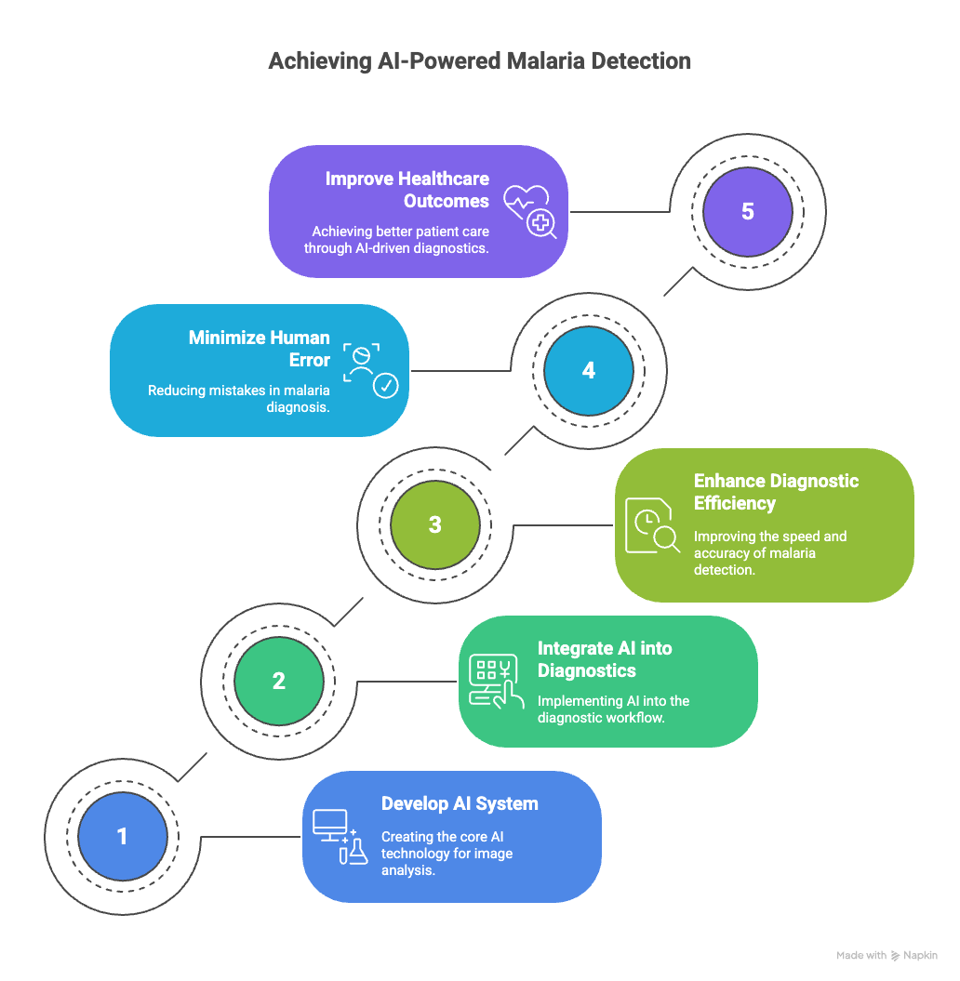
Problem Statement
Is it possible to create an automated and Artificial Intelligence based image classification tool, to be able to determine malaria with cell images with high precision, increase the speed of diagnosis, and decrease the human factor?
In this project, we will be developing a deep learning classification model which will be able to:
Correctly distinguish between cells parasitized and uninfected.
Help medical workers to save on the time of diagnosing.
Allow scalability to low resource clinical applications through minimal and understandable AI models (e.g, mobile applications, single board computers).
Page 3

Slide 6
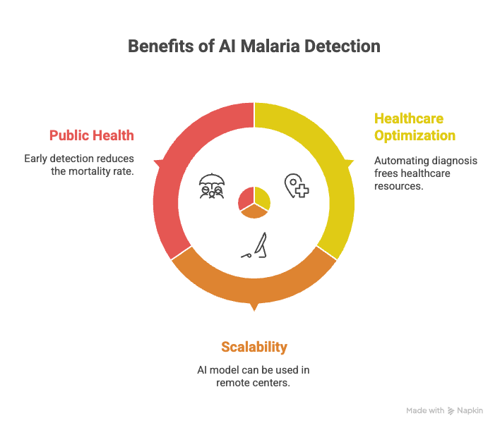
Potential Impact
Healthcare Optimization: Automating the diagnosis process can free up valuable healthcare resources.
Scalability: A deployable AI model can be utilized in remote or under-equipped healthcare centers.
Public Health: Early detection leads to timely intervention, ultimately reducing the mortality rate caused by malaria.
Page 4

Slide 7
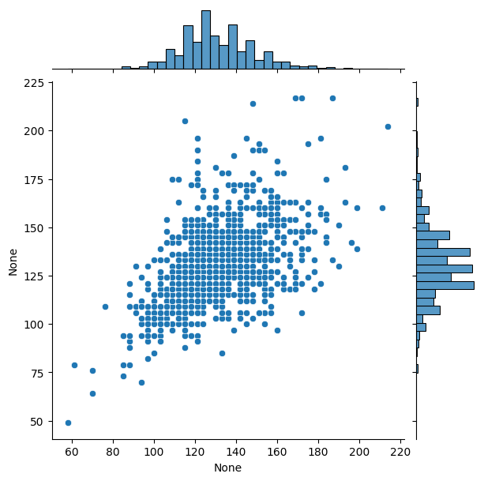
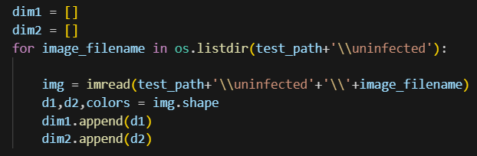
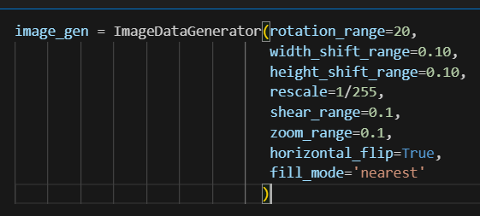
CNN Model from Scratch
Project Overview:
Objective: Classify microscopic cell images as Parasitized or Uninfected
Dataset: Public malaria dataset with separate train/ and test/ folders
Tools used: Python, TensorFlow/Keras, CNN, Seaborn, Matplotlib
Data Prep:
Data Prep:
Image loading & resizing
Normalization & one-hot encoding
Data augmentation using ImageDataGenerator
Page 5

Slide 8

CNN Model from Scratch
CNN Model:
Conv2D (x2) → BatchNorm → ReLU → MaxPooling → GlobalAvgPooling → Dense Layers → Dropout → Sigmoid Output
Used GlobalAveragePooling2D instead of Flatten to reduce model parameters, minimize overfitting,
Trained the CNN for 10 epochs using early stopping and model checkpointing to prevent overfitting and save the best-performing model.
Results:
Achieved strong accuracy in detecting malaria (92.98%)
Applied an 80% confidence threshold for predictions to reduce false positives and improve model reliability in sensitive medical diagnosis.
Visualized metrics: confusion matrix, classification report
Page 6

Slide 9
Classification with VGG16: Colab notebook
VGG16 is a pre-trained Convolutional Neural Network (CNN)
Instead of training a model from scratch (which needs a huge dataset and a lot of time), we used Transfer Learning:
We reused VGG16's knowledge to detect visual patterns in malaria cell images.
This saves computational cost and gives high accuracy even with a smaller medical dataset.
We loaded the VGG16 model without its top layers and kept its weights frozen so we could use it as a feature extractor.
Added Custom Layers for Our Task
GlobalAveragePooling2D(): Converts VGG16's output into a 1D vector.
Dense(128, activation='relu'): Adds a fully connected layer to learn specific patterns.
Dropout(0.5): Reduces overfitting by randomly turning off neurons during training.
Dense(1, activation='sigmoid'): Final output layer to classify cells as Infected (1) or Uninfected (0).
Compiled the Model
Optimizer: Adam with a low learning rate (0.0001) for gentle fine-tuning and so we didn’t disrupt the pretrained VGG weights.
Loss function: Binary Crossentropy because it’s a binary classification problem.
Metrics: We tracked accuracy during training.
We also used EarlyStopping and ModelCheckpoint to make sure we saved the best model during training.
Page 7

Slide 10
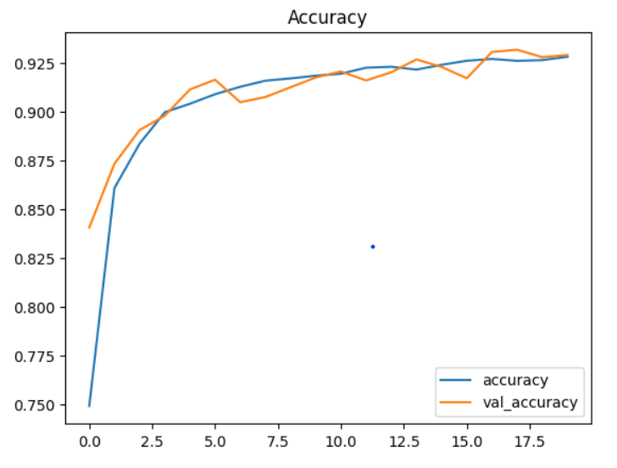
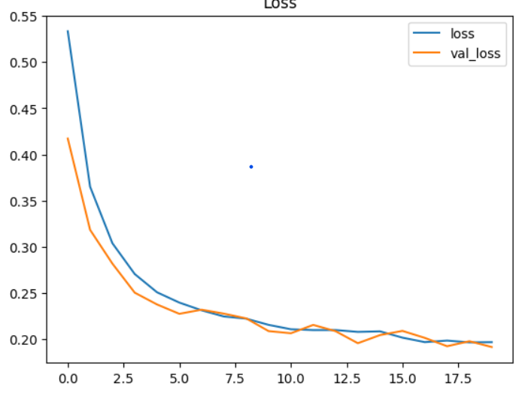
VGG16:
Total params: 14.78 (56.38 MB)
Trainable params: 65,793 (257.00 KB)
Non-trainable params: 14.7 (56.13 MB)
93% accuracy
20 epochs
Page 8

Slide 11
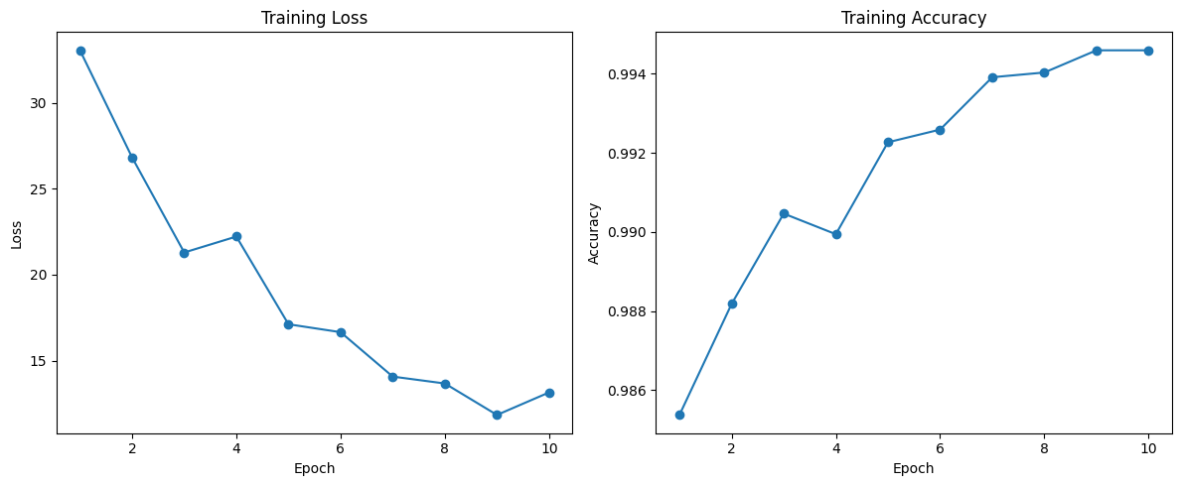
Classification with Vision Transformers (ViT)
2. Workflow Overview
a. Data Preparation
Dataset: Cell images, split into train/test folders
Preprocessing:
Resize to 224x224
Normalize: img = (img - 0.5) / 0.5
Check & remove corrupted images
b. Model
Pretrained model: vit_tiny_patch16_224 from timm library
c. Training
Optimizer: Adam
Loss: CrossEntropyLoss
Epoch 10
Head-only: Only head parameters trainable (Trainable parameters: 386)
Fine-tuning: All parameters trainable (Total Parameters: 5,524,802)
d. Evaluation
Visualization with Loss/accuracy curves
Metrics: Confusion Matrix, Classification Report
Colab Link
1. Project Goal
ViT is a Transformer-based pre-trained model for image classification tasks.
Classify malaria cell images as Parasitized or Uninfected
Compare:
Training only the classification head (head-only transfer learning)
Fine-tuning all layers (full model)
Full Fine-tuning training loss and accuracy curves
Page 9

Slide 12
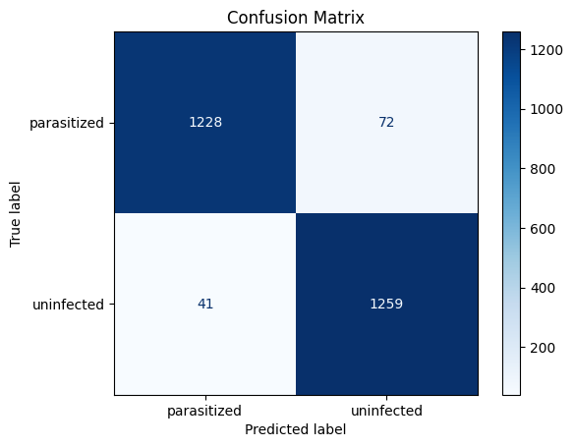

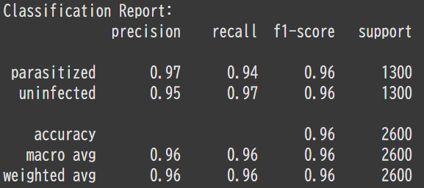
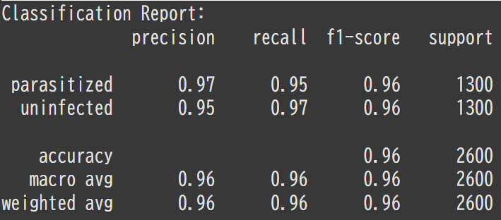
Training only the classification head (head-only transfer learning)
Fine-tuning all layers (full model)
Page 10

Slide 13
Comparison of All Models
Model | Accuracy (%) | Params | Training Type | Key Strengths
CNN from Scratch | 92.98 | ~1M (custom) | Full Training | Lightweight, custom-built
VGG16 (Transfer Learning) | 93 | 14.78M (mostly frozen) | Feature Extraction + Custom Head | Strong accuracy with minimal compute
ViT - Head Only | 96 | 5.5M (Trainable parameters: 386) | Classification Head Only | Extremely low trainable parameters
ViT - All Layers | 96 | 5.5M | Full Fine-Tuning | High performance, data-efficient
Page 11

Slide 14
Most Effective Model?
ViT Head-Only Variant
Test low-compute transfer learning
Train only classification head (386 params)
Recall
Measures how many actual malaria cases the model catches
ViT - All Layers achieved recall of 95%
ViT Head-Only achieved recall 94%, even with limited training
Page 12

Slide 15
Streamlit Demo
Deployment Objective
Deliver a user-friendly web app for malaria detection using deep learning.
Built with scalability and low-resource accessibility in mind.
App Architecture
Developed with Streamlit for rapid prototyping and visual interactivity.
Modular design: image upload → model inference → confidence visualization.
Integrated Models
CNN from Scratch – Custom baseline model.
VGG16 (Keras) – Transfer learning approach.
ViT Head-Only – Vision Transformer with frozen base.
ViT Fine-Tuned – Fully trainable Vision Transformer.
Unified preprocessing: RGB conversion, resizing (224×224), normalization.
Inference Pipeline
One image input → feeds all 4 models.
Outputs:
Prediction class (Infected / Uninfected)
Confidence score per model
Side-by-side results for comparison.
Tech Stack
PyTorch (CNN & ViT), TensorFlow/Keras (VGG16)
timm – Model loading for ViT
Pillow – Image handling
Streamlit – UI deployment
Runtime Management
Targeted Python 3.10 for compatibility.
Carefully aligned versions: torch==2.1.0, torchvision==0.16.0, tensorflow==2.16.1.
Solved environment conflicts and deployment errors for smooth cloud deployment.
Page 13

Slide 16
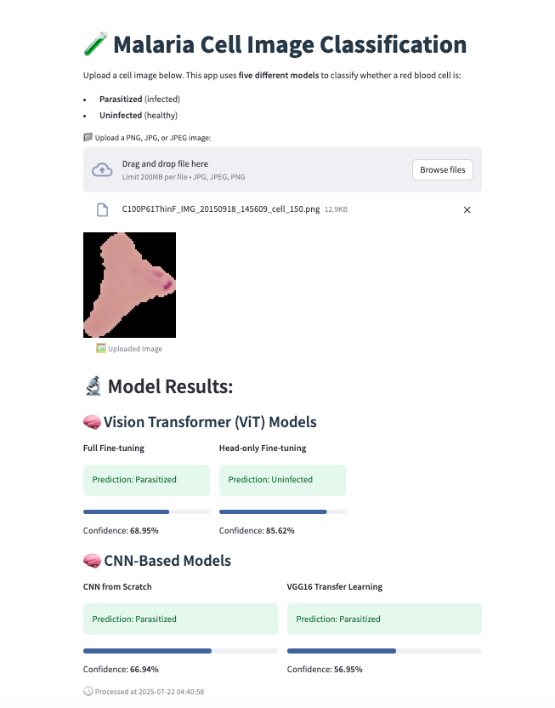

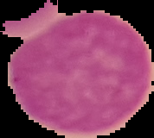
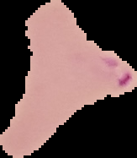
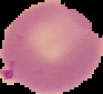
Streamlit Demo
Uninfected
DEMO
LINK
Parasitized
Page 14

Slide 17
Conclusion
Successfully developed and compared three deep learning models (Custom CNN, VGG16, and ViT) for binary classification of malaria-infected cell images.
Achieved high accuracy (up to 93%) with transfer learning (VGG16) and (96% accuracy) with ViT (fine-tuned)
Build a Streamlit web app for real-time malaria diagnosis-enabling fast, accessible, and scalable development.
Demonstrated that AI can significantly reduce diagnostic time and assist healthcare professionals in resource-constrained environments.
Page 15

Slide 18
Future Work
Integrate larger and diverse datasets to improve generalization and reduce potential bias.
Implement real-time mobile deployment for offline usage in remote clinic settings.
Explore self-supervised learning and few-shot learning to reduce dependency on labeled data.
Conduct clinical trails or partnerships with health institutions to validate the model’s real-world effectiveness.
Enhance the app with features like bath processing, explainable AI visualizations, and multilingual UI.
Page 16

